Slide 1
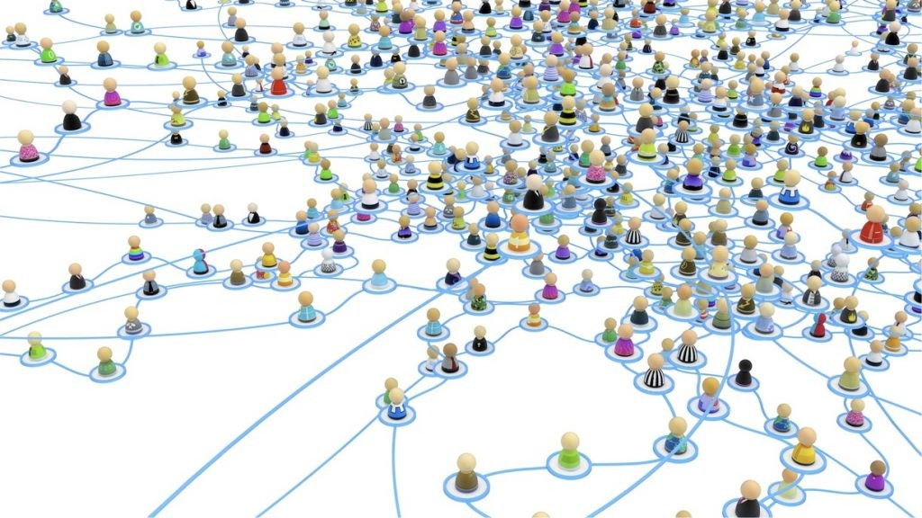
Topic 8: Network Effects
Industrial Organisation / Matěj Bajgar

Slide 2

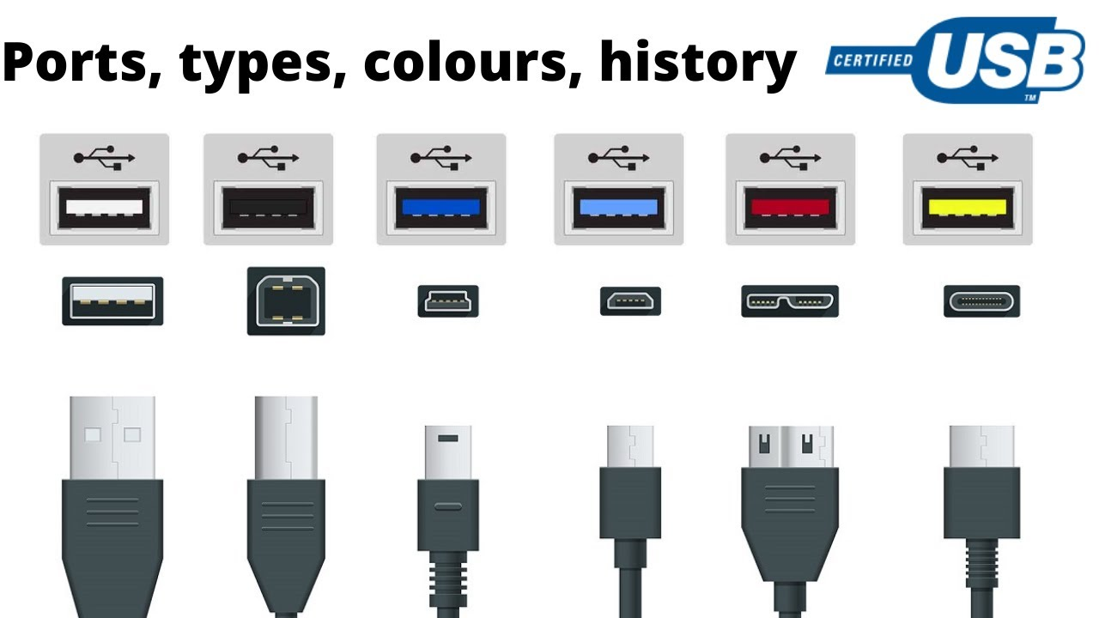
Why should I care?

Slide 3
Roadmap
Roadmap
Direct vs. indirect network effects
A model of network externalities
Critical mass
Standardisation

Slide 4
Roadmap
Roadmap
Direct vs. indirect network effects
A model of network externalities
Critical mass
Standardisation

Slide 5
Network effects
Exhibited by a product if each user‘s utility increases in the number of other users or the number of compatible products.

Slide 6
Direct network effects
Buyers form a network of users who communicate with each other
One-sided markets

Slide 7


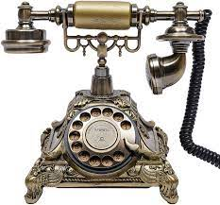


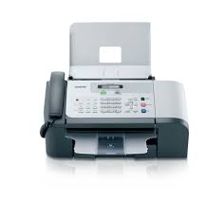

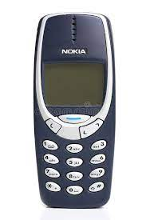


Direct network effects

Slide 8


Direct network effects

Slide 9


Direct network effects

Slide 10

Direct network effects

Slide 11

Direct network effects
Notes:
Grindr

Slide 12

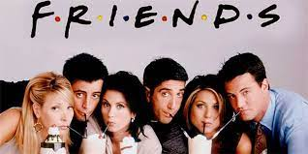
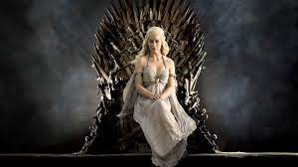

Direct network effects

Slide 13
Indirect network effects
Buyers stimulate production of complementary goods that enhance the value of the original product
Multi-sided markets

Slide 14




Indirect network effects

Slide 15
Indirect network effects

Slide 16


Indirect network effects

Slide 17
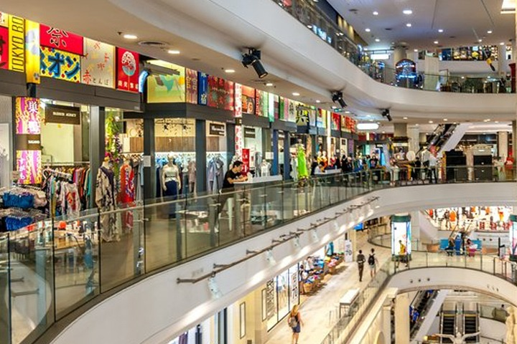
Indirect network effects

Slide 18



Indirect network effects

Slide 19


Indirect network effects

Slide 20
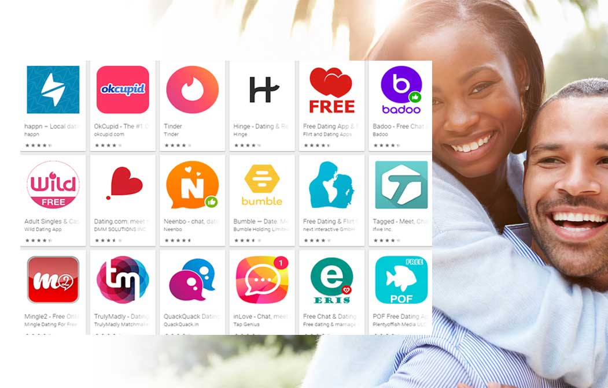
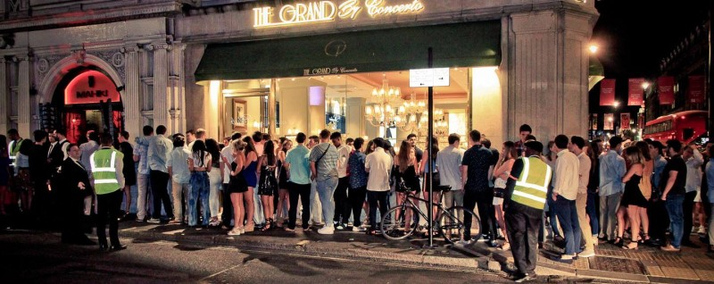
Indirect network effects

Slide 21
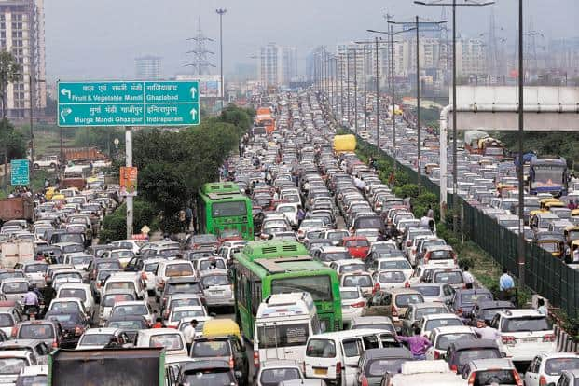
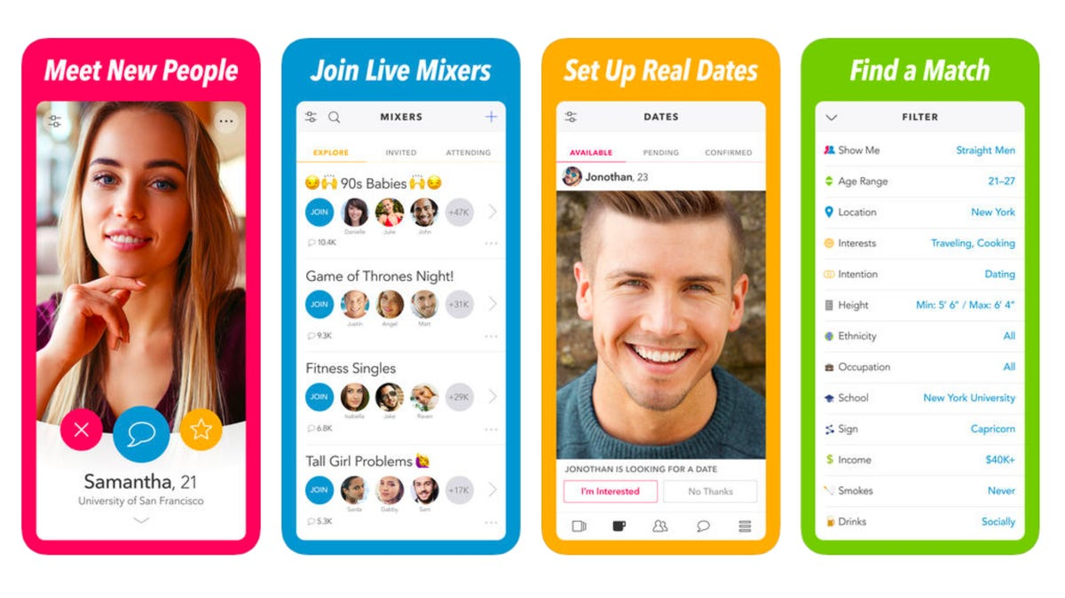


Negative network effects
There can also be negative network effects (congestion externalities)
Direct
Traffic Males on heterosexual dating sites
Indirect
TV audience ➔ TV commercials Tourists ➔ tourist shows/restaurants

Slide 22
Roadmap
Roadmap
Direct vs. indirect network effects
A model of network externalities
Critical mass
Standardisation

Slide 23
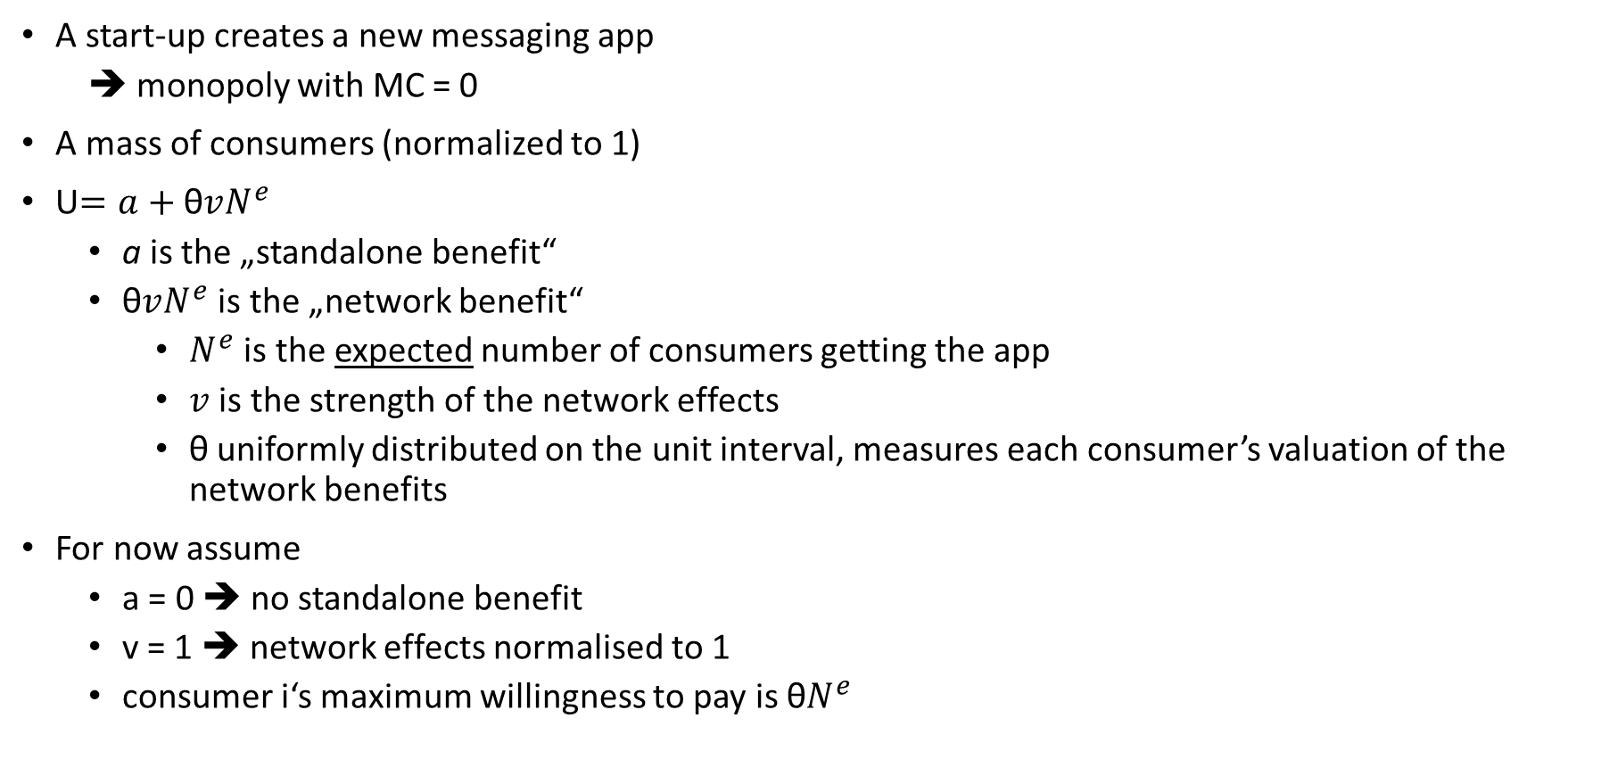
A model of network externalities
A start-up creates a new messaging app
➔ monopoly with MC = 0
A mass of consumers (normalized to 1)
U$=a+\text{θ}vN^{e}$
a is the „standalone benefit“
$\text{θ}vN^{e}$ is the „network benefit“
$N^{e}$ is the expected number of consumers getting the app
$v$ is the strength of the network effects
$\text{θ}$ uniformly distributed on the unit interval, measures each consumer’s valuation of the network benefits
For now assume
a = 0 ➔ no standalone benefit
v = 1 ➔ network effects normalised to 1
consumer i‘s maximum willingness to pay is $\text{θ}N^{e}$

Slide 24
A model of network externalities
Two stages
The monopoly sets the price p
Consumers simultaneously decide whether to purchase
What are subgame perfect equilibria of this game?

Slide 25
A model of network externalities
Stage 2
Price p>0 taken as given in stage 2
Equilibrium 1 (with any p>0) – noone purchases
Expectations fulfilled
Noone want‘s to deviate as it would mean paying p>0 but getting zero utility from the app
Other equilibria?

Slide 26
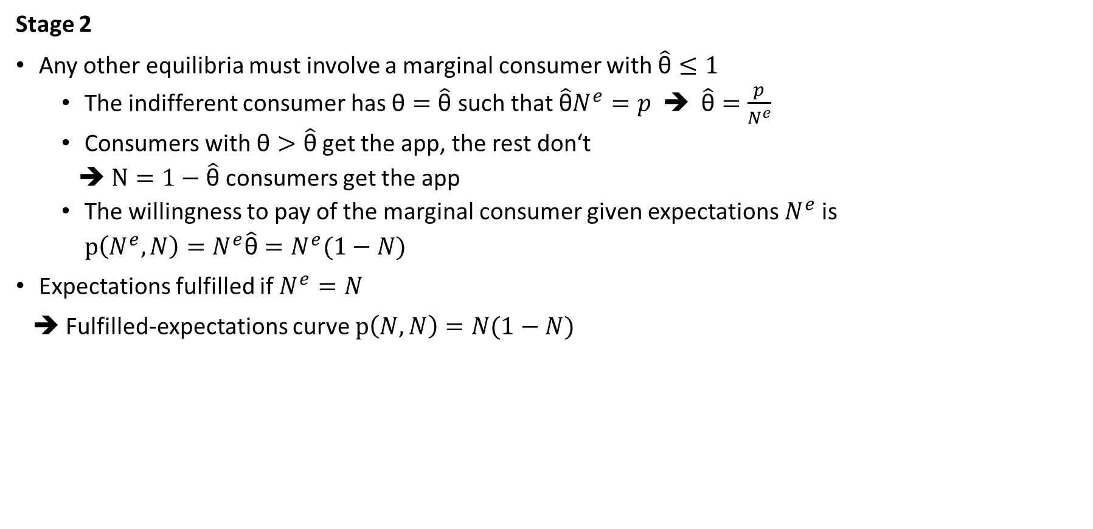
A model of network externalities
Stage 2
Any other equilibria must involve a marginal consumer with $\hat{\text{θ}}≤1$
The indifferent consumer has $\text{θ}=\hat{\text{θ}}$ such that $\hat{\text{θ}}N^{e}=p$ ➔ $\hat{\text{θ}}=\frac{p}{N^{e}}$
Consumers with $\text{θ}>\hat{\text{θ}}$get the app, the rest don‘t
➔ $N=1−\hat{\text{θ}}$ consumers get the app
The willingness to pay of the marginal consumer given expectations $N^{e}$is
$p\left(N^{e},N\right)=N^{e}\hat{\text{θ}}=N^{e}(1−N)$
Expectations fulfilled if $N^{e}=N$
➔ Fulfilled-expectations curve $p\left(N,N\right)=N(1−N)$

Slide 27
A model of network externalities
Stage 2
N(1-N) maximised if N = 0.5, then N(1-N)=0.25
If p>0.25, condition p = N(1-N) cannot be satisfied ➔ N=0 is the only Nash equilibrium
If p = 0.25, then the condition has the only solution at N = 0.5 ➔ Two Nash equilibria at N=0 and N=0.5
If 0<p<0.25, then the condition has 2 solutions N₋ and N₊ such that N₋ < 0.5 < N₊
➔ 3 Nash equilibria N=0, N₋, N₊

Slide 28
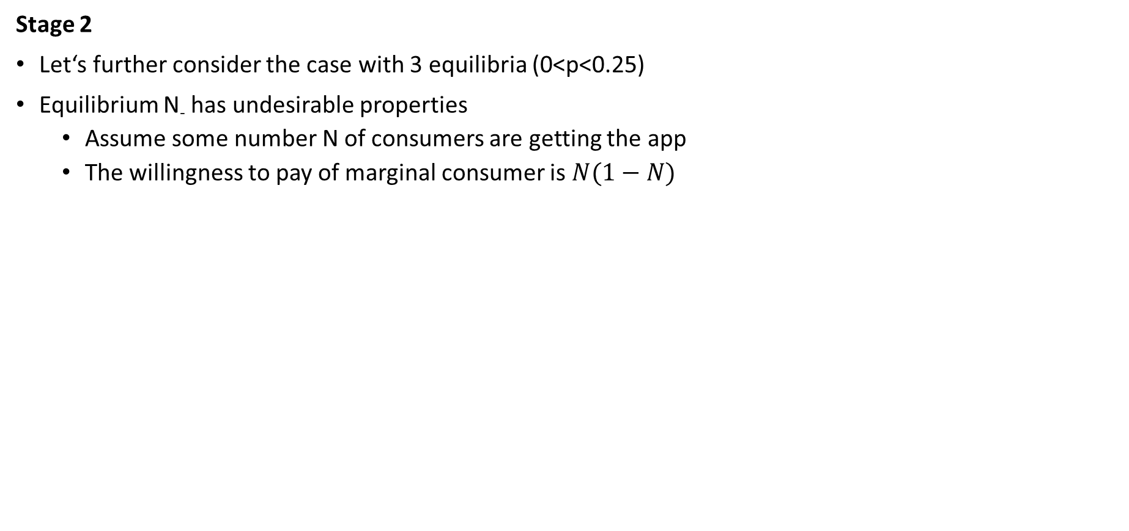
A model of network externalities
Stage 2
Let‘s further consider the case with 3 equilibria (0<p<0.25)
Equilibrium N₋ has undesirable properties
Assume some number N of consumers are getting the app
The willingness to pay of marginal consumer is $N(1−N)$

Slide 29
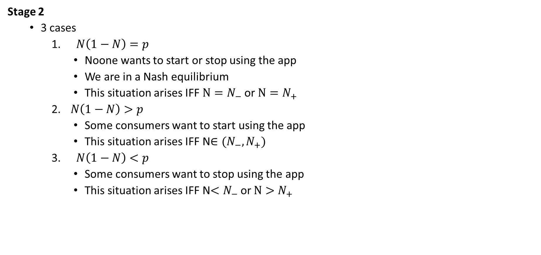
A model of network externalities
Stage 2
3 cases
$N\left(1−N\right)=p$
Noone wants to start or stop using the app
We are in a Nash equilibrium
This situation arises IFF $N=N_{−}$ or $N=N_{+}$
$N\left(1−N\right)>p$
Some consumers want to start using the app
This situation arises IFF N$∈(N_{−},N_{+})$
$N\left(1−N\right)<p$
Some consumers want to stop using the app
This situation arises IFF N$<N_{−}$or $N>N_{+}$

Slide 30
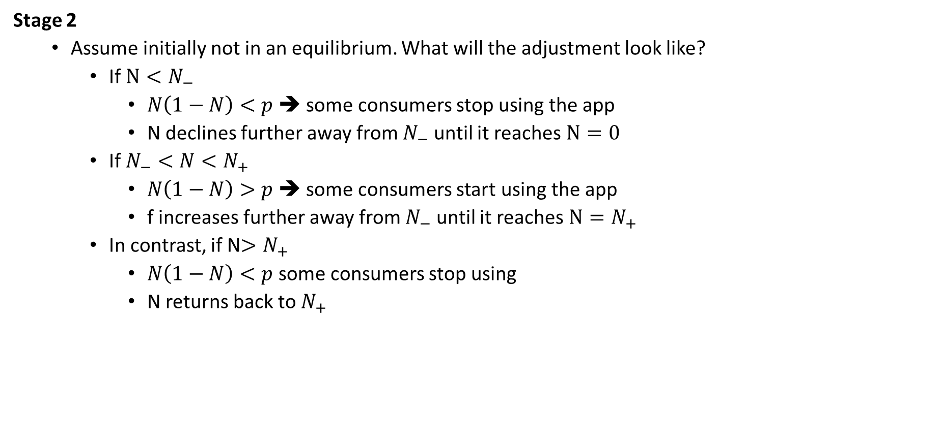
A model of network externalities
Stage 2
Assume initially not in an equilibrium. What will the adjustment look like?
If $N<N_{−}$
$N\left(1−N\right)<p$ ➔ some consumers stop using the app
N declines further away from $N_{−}$ until it reaches $N=0$
If $N_{−}<N<N_{+}$
$N\left(1−N\right)>p$ ➔ some consumers start using the app
f increases further away from $N_{−}$ until it reaches $N=N_{+}$
In contrast, if N$>N_{+}$
$N\left(1−N\right)<p$ some consumers stop using
N returns back to $N_{+}$

Slide 31
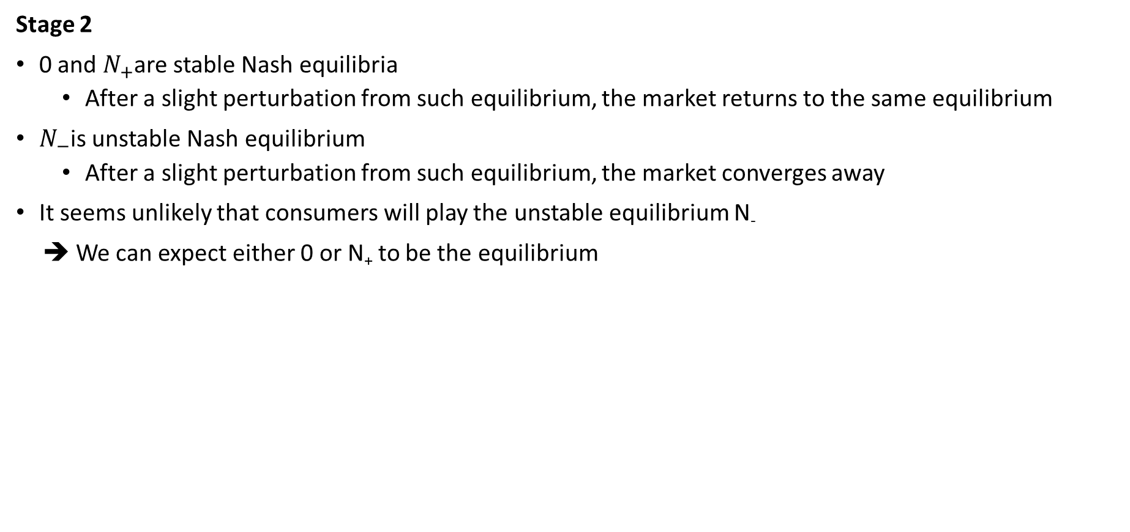
A model of network externalities
Stage 2
0 and $N_{+}$are stable Nash equilibria
After a slight perturbation from such equilibrium, the market returns to the same equilibrium
$N_{−}$is unstable Nash equilibrium
After a slight perturbation from such equilibrium, the market converges away
It seems unlikely that consumers will play the unstable equilibrium N₋
➔ We can expect either 0 or N₊ to be the equilibrium

Slide 32
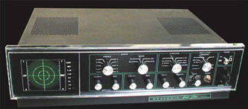
A model of network externalities
Stage 2
N₋ represents the critical mass which leads to the buildup of the network
Once the number of consumers reaches N₋, there is a snowball effect and the demand converges to the high equilibrium
But some firms may never reach the critical mass!
Example 1: Quadrophonic sound
Supposed to replace stereo in 1970s
Widely perceived as offering superior sound
But consumers feared no enough records and record companies feared not enough consumers able to play them
➔ never took off

Slide 33
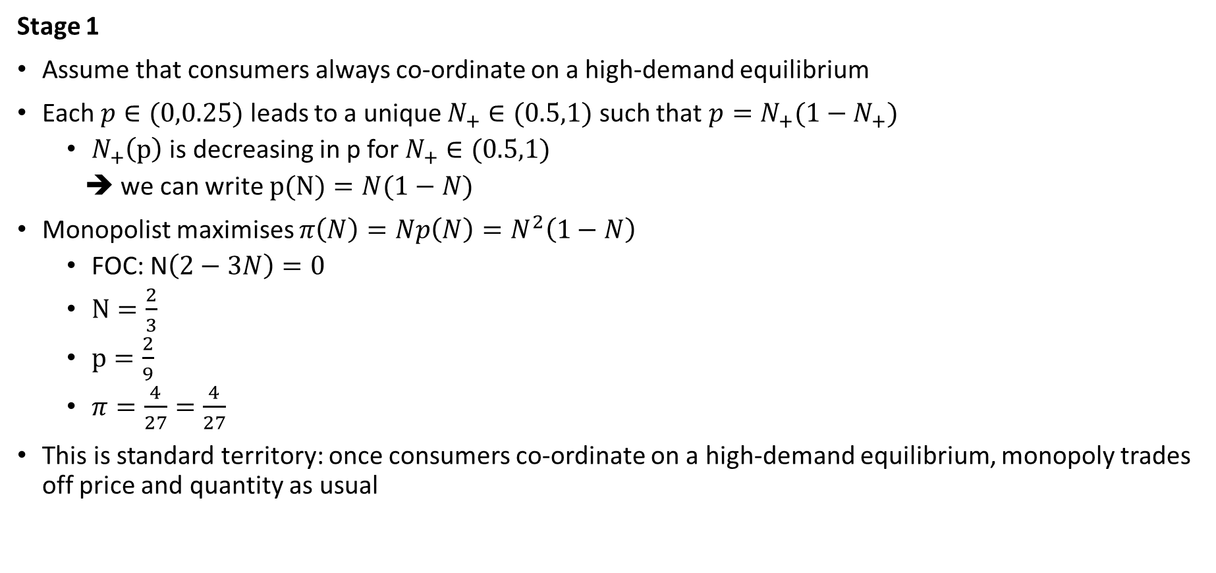
A model of network externalities
Stage 1
Assume that consumers always co-ordinate on a high-demand equilibrium
Each $p∈(0,0.25)$ leads to a unique $N_{+}∈(0.5,1)$ such that $p=N_{+}(1−N_{+})$
$N_{+}\left(p\right)$ is decreasing in p for $N_{+}∈(0.5,1)$
➔ we can write $p(N)=N(1−N)$
Monopolist maximises $π\left(N\right)=Np\left(N\right)=N^{2}\left(1−N\right)$
FOC: N$\left(2−3N\right)=0$
$N=\frac{2}{3}$
$p=\frac{2}{9}$
$π=\frac{4}{27}=\frac{4}{27}$
This is standard territory: once consumers co-ordinate on a high-demand equilibrium, monopoly trades off price and quantity as usual

Slide 34
Exercise 1: Network effects and fulfilled expectations
Consumers differ in their valuation of network benefits:
U(θ) = a + θvN^{e}
a measures standalone benefit
v measures network benefit
N^{e} is the expected number of users
θ uniformly di stributed on the unit interval
Identify the indifferent consumer for a given price p and network size N^{e}
Express the willingness to pay for Nth unit of the good when N^{e} units are expected to be sold. Check the “law of demand” conflicts with the “market expansion effect”
Express the fulfilled expectations demand curve and draw it for the cases of strong network effects (v>a) and weak network effects (v<a).
What equilibria are there in each case? Which equilibria are stable?

Slide 35
Exercise 2: Network effects and fulfilled expectations
Consumers differ in their valuation of network benefits:
U(θ) = θ(a + vN^{e})
a measures standalone benefit
v measures network benefit
N^{e} is the expected number of users
θ uniformly di stributed on the unit interval
Identify the indifferent consumer for a given price p and network size N^{e}
Express the willingness to pay for Nth unit of the good when N^{e} units are expected to be sold. Check the “law of demand” conflicts with the “market expansion effect”
Express the fulfilled expectations demand curve and draw it for the cases of strong network effects (v>a) and weak network effects (v<a).
What equilibria are there in each case? Which equilibria are stable?

Slide 36
Exercise 3: Network effects and fulfilled expectations
Consumers differ in their valuation of standalone benefits:
U(θ) = θa + vN^{e}
a measures standalone benefit
v measures network benefit
N^{e} is the expected number of users
θ uniformly distributed on the unit interval
Identify the indifferent consumer for a given price p and network size N^{e}
Express the willingness to pay for Nth unit of the good when N^{e} units are expected to be sold. Check the “law of demand” conflicts with the “market expansion effect”
Express the fulfilled expectations demand curve and draw it for the cases of strong network effects (v>a) and weak network effects (v<a).
What equilibria are there in each case? Which equilibria are stable?

Slide 37
Roadmap
Roadmap
Direct vs. indirect network effects
A model of network externalities
Critical mass
Standardisation

Slide 38
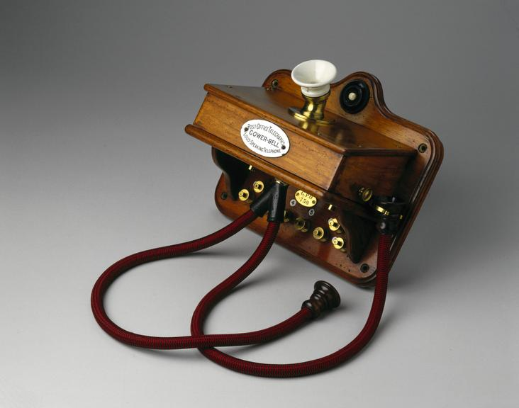
Consumer expectations and critical mass
How to ensure critical mass (direct network externalities)
Penetration pricing (introductory pricing)
Set a low price until reaching initial mass
Example: the Bell company when telephones introduced to the US in 1880s

Slide 39
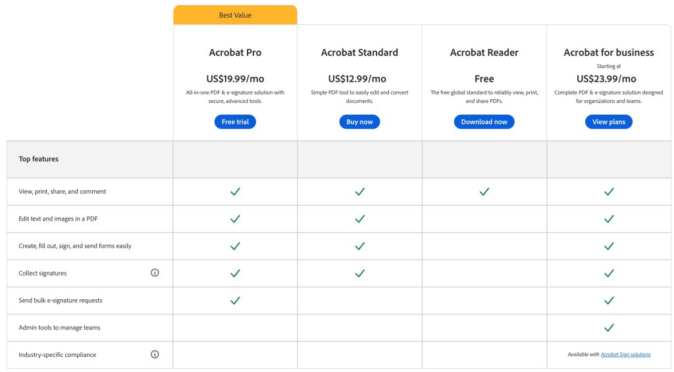
Consumer expectations and critical mass
How to ensure critical mass (direct network externalities)
Price discrimination between groups of consumers
Give away some versions for free to one group of customers (e.g. households)
Charge high price to another group of customers (e.g. companies)
Example : Adobe Acrobat Reader (free) vs. Adrobe Acrobat Pro (expensive)

Slide 40

Consumer expectations and critical mass
How to ensure critical mass (direct network externalities)
Software piracy
Companies lenient on piracy to increase the size of the network (can be seen as a form of price discrimination, with people using pirated copies having highly elastic demand)
Example : Microsoft could be more aggresive against illegal copies of Windows or Office

Slide 41
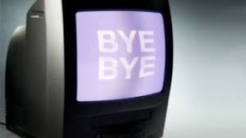
Consumer expectations and critical mass
How to ensure critical mass (direct network externalities)
Government intervention
Example : Analog TV Broadcasting in Czechia discontinued on 12th February 2012

Slide 42
Consumer expectations and critical mass
How to ensure critical mass (indirect network externalities)
Price discrimination between two sides of the market
➔ Subsidise the side of market where demand more price elastic

Slide 43
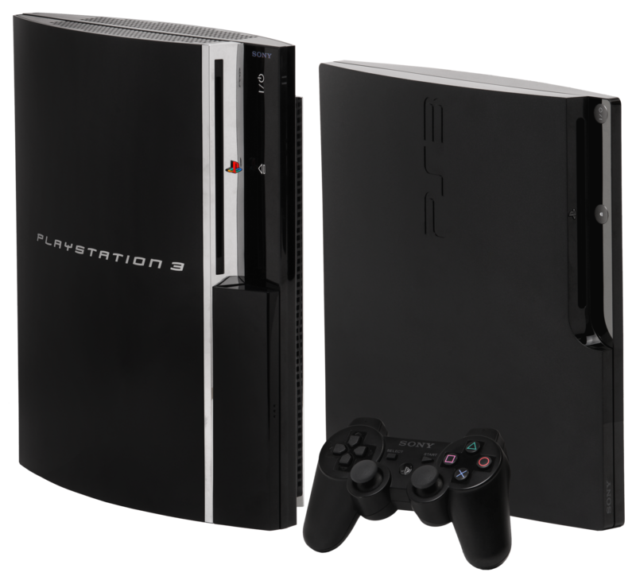
Consumer expectations and critical mass
How to ensure critical mass (indirect network externalities)
Price discrimination between two sides of the market
➔ Subsidise the side of market where demand more price elastic
Example 1: Video console and game market
Positive externalities between owners of consoles and game developers
Console manufacturers (Sony, Microsoft, Nintedo...) subsidise consumers by selling consoles below marginal costs
They charge high price (development kits, royalties) to game developers
E.g.: In 2006, price of Playstation 3 (inc. Blu Ray drive) was less than a price of a Blu Ray drive only

Slide 44
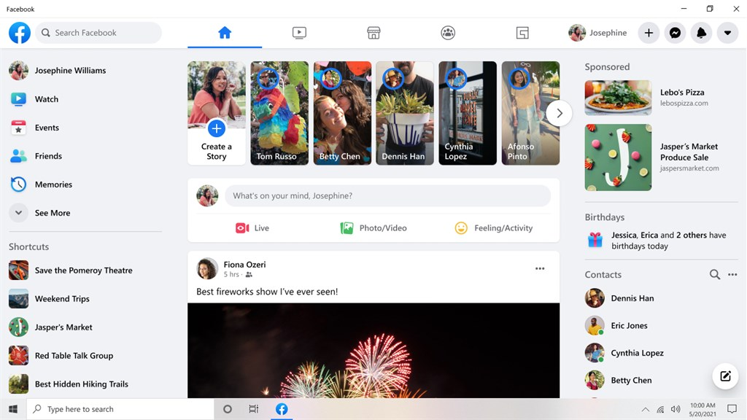
Consumer expectations and critical mass
How to ensure critical mass (indirect network externalities)
Price discrimination between two sides of the market
➔ Subsidise the side of market where demand more price elastic
Example 2: Facebook
Membership in the social network free, but high prices for advertisers

Slide 45
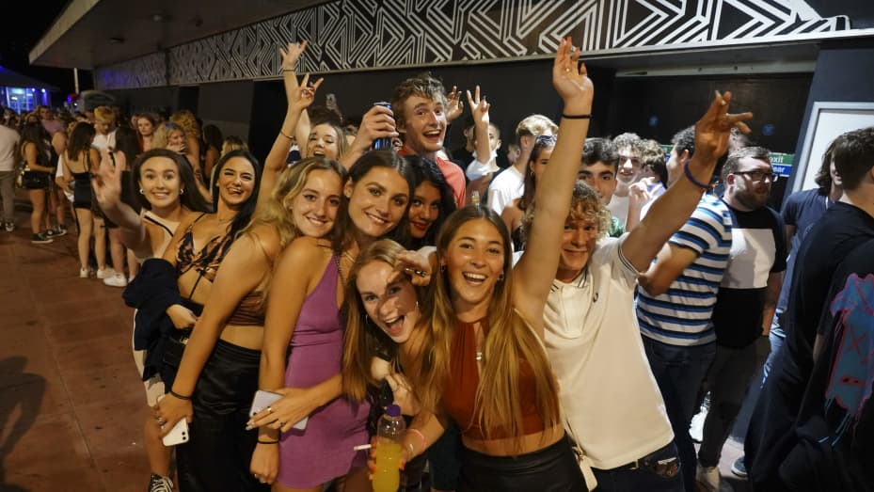
Consumer expectations and critical mass
How to ensure critical mass (indirect network externalities)
Price discrimination between two sides of the market
➔ Subsidise the side of market where demand more price elastic
Example 3: Nightclubs
Free entry/drings for women, high prices for men

Slide 46
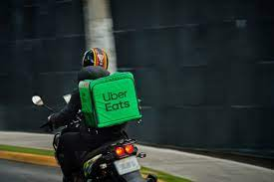
Decreasing returns to network effects?
Sometimes network effects exist initially but fade out once a certain scale of the market is reached
Example: Uber
Initially, more cars ➔ more passangers ; more passangers ➔ more cars
Beyond a certain level, I don‘t care if there are 3 or 30 cars within 2 mins from me
➔ Not too difficult to build a competing platform in a city
A serious problem to Uber business ➔ stock value today 40% below 2019 IPO
Instead trying to make money through other means than taxi
Counter-example: Facebook
It still makes a difference whether 50% of my friends are there or 100% of my friends are there
Building competition much harder

Slide 47
Roadmap
Roadmap
Direct vs. indirect network effects
A model of network externalities
Critical mass
Standardisation

Slide 48
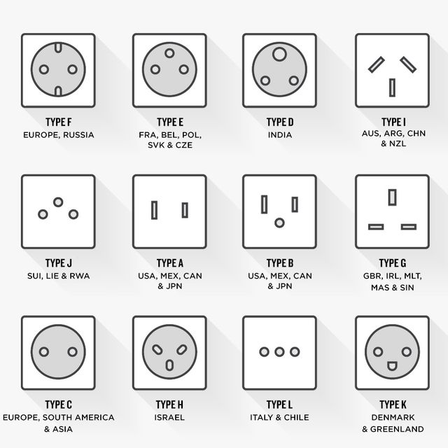
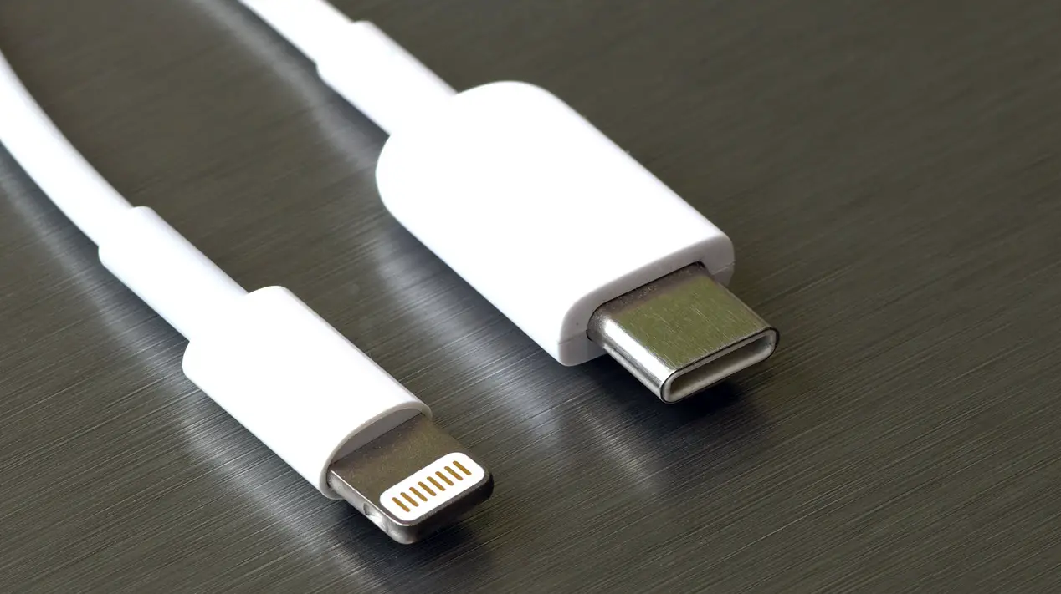
Standardisation
When we think about network effects, we tend to imagine things like
But network effects are also important for things like

Slide 49
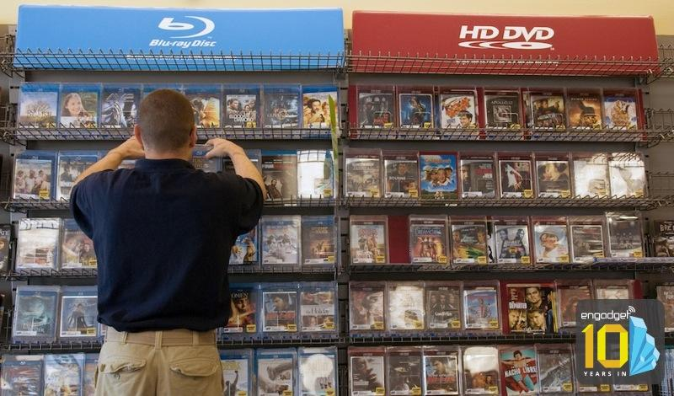
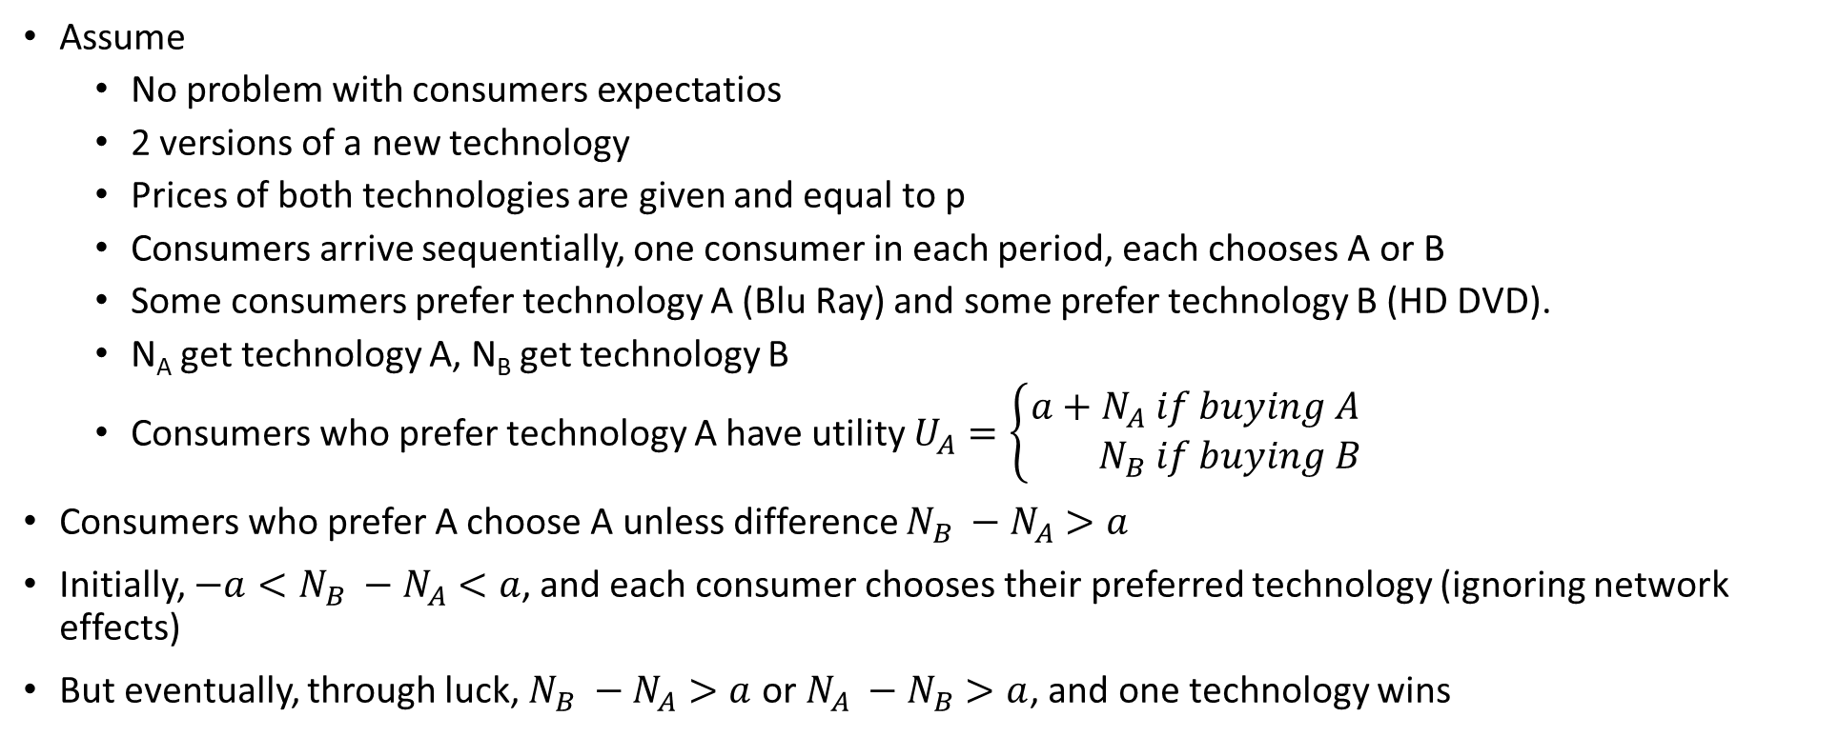
Standardisation
Assume
No problem with consumers expectatios
2 versions of a new technology
Prices of both technologies are given and equal to p
Consumers arrive sequentially, one consumer in each period, each chooses A or B
Some consumers prefer technology A (Blu Ray) and some prefer technology B (HD DVD).
N_{A} get technology A, N_{B} get technology B
Consumers who prefer technology A have utility $U_{A}=\left\{\begin{aligned}a+N_{A} if buying A \\ N_{B} if buying B\end{aligned}\right.$
Consumers who prefer A choose A unless difference $N_{B} −N_{A}>a$
Initially, ${−a<N}_{B} −N_{A}<a$, and each consumer chooses their preferred technology (ignoring network effects)
But eventually, through luck, $N_{B} −N_{A}>a$ or $N_{A} −N_{B}>a$, and one technology wins

Slide 50
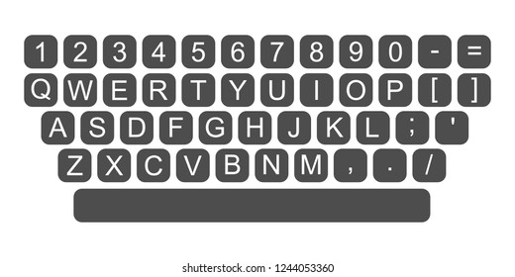
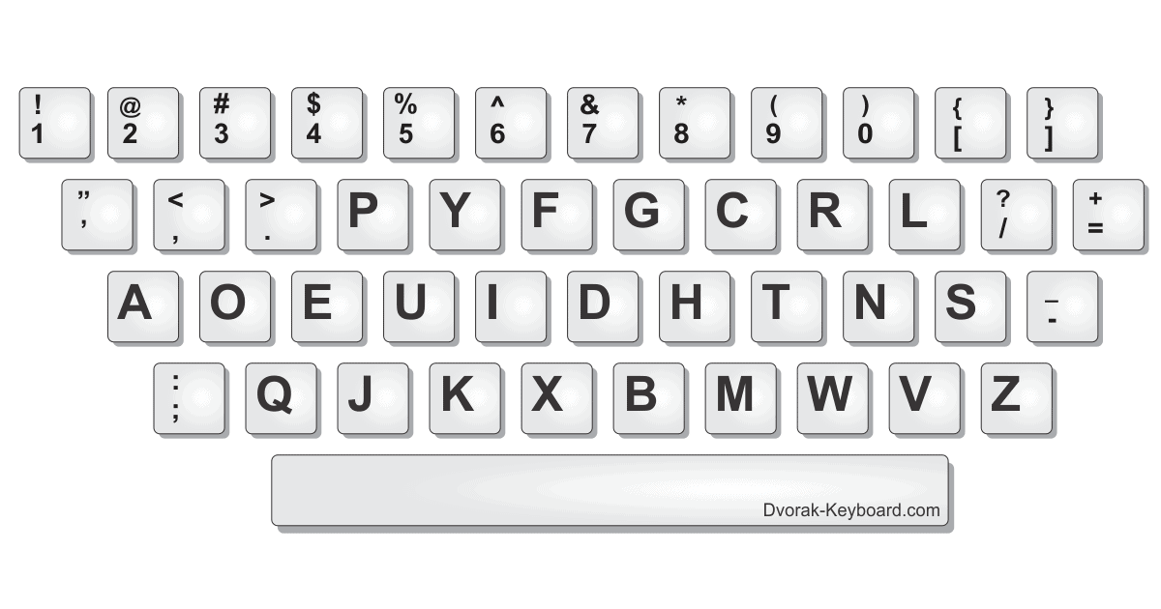
Standardisation
A very simple model but highlights
Sooner or later an industry gets locked in
The winning product may not be the better one (especially if starting later)
History can play a big role
Example: QWERTY vs. Dvorak
QWERTY layout designed to prevent typebars from clashing and jamming in 19th century typewriters
In the 1930s, August Dvorak proposed another keyboard layout, which was intended to maximize typing speed
Dvorak Never took off because of network effects and we are stuck with QWERTY

Slide 51
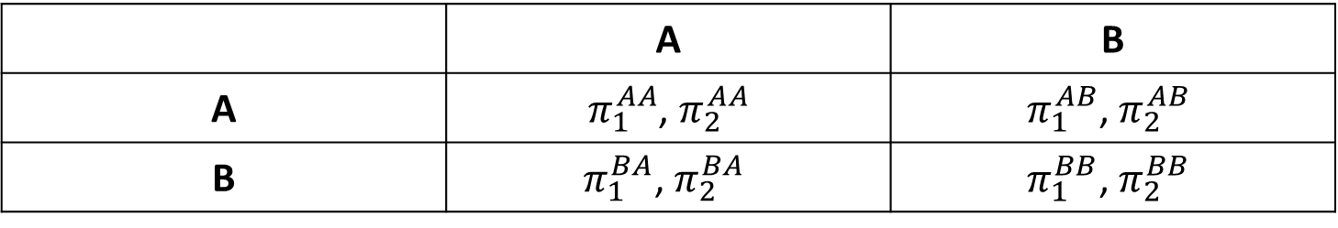
Standardisation game
Two firms (1 and 2), choosing between version A and B of network good
The two versions are initially incompatible, compatibility only achieved by standardisation
 | A | B
A | $π_{1}^{AA}$, $π_{2}^{AA}$ | $$π_{1}^{AB}\text{,} π_{2}^{AB}$$
B | $$π_{1}^{BA}\text{,} π_{2}^{BA}$$ | $$π_{1}^{BB}\text{,} π_{2}^{BB}$$

Slide 52


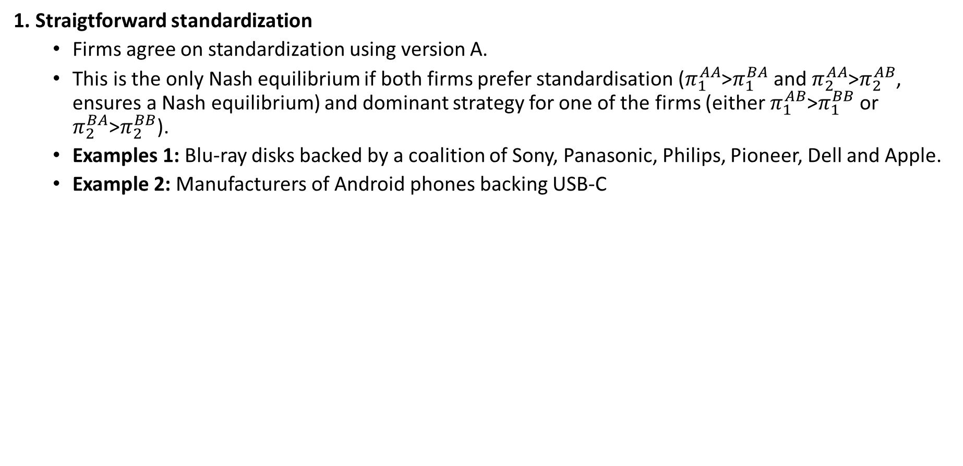
Standardisation game: 4 options
1. Straigtforward standardization
Firms agree on standardization using version A.
This is the only Nash equilibrium if both firms prefer standardisation ($π_{1}^{AA}$>$π_{1}^{BA}$ and $π_{2}^{AA}$>$π_{2}^{AB}$, ensures a Nash equilibrium) and dominant strategy for one of the firms (either $π_{1}^{AB}$>$π_{1}^{BB}$ or $π_{2}^{BA}$>$π_{2}^{BB}$).
Examples 1: Blu-ray disks backed by a coalition of Sony, Panasonic, Philips, Pioneer, Dell and Apple.
Example 2: Manufacturers of Android phones backing USB-C

Slide 53
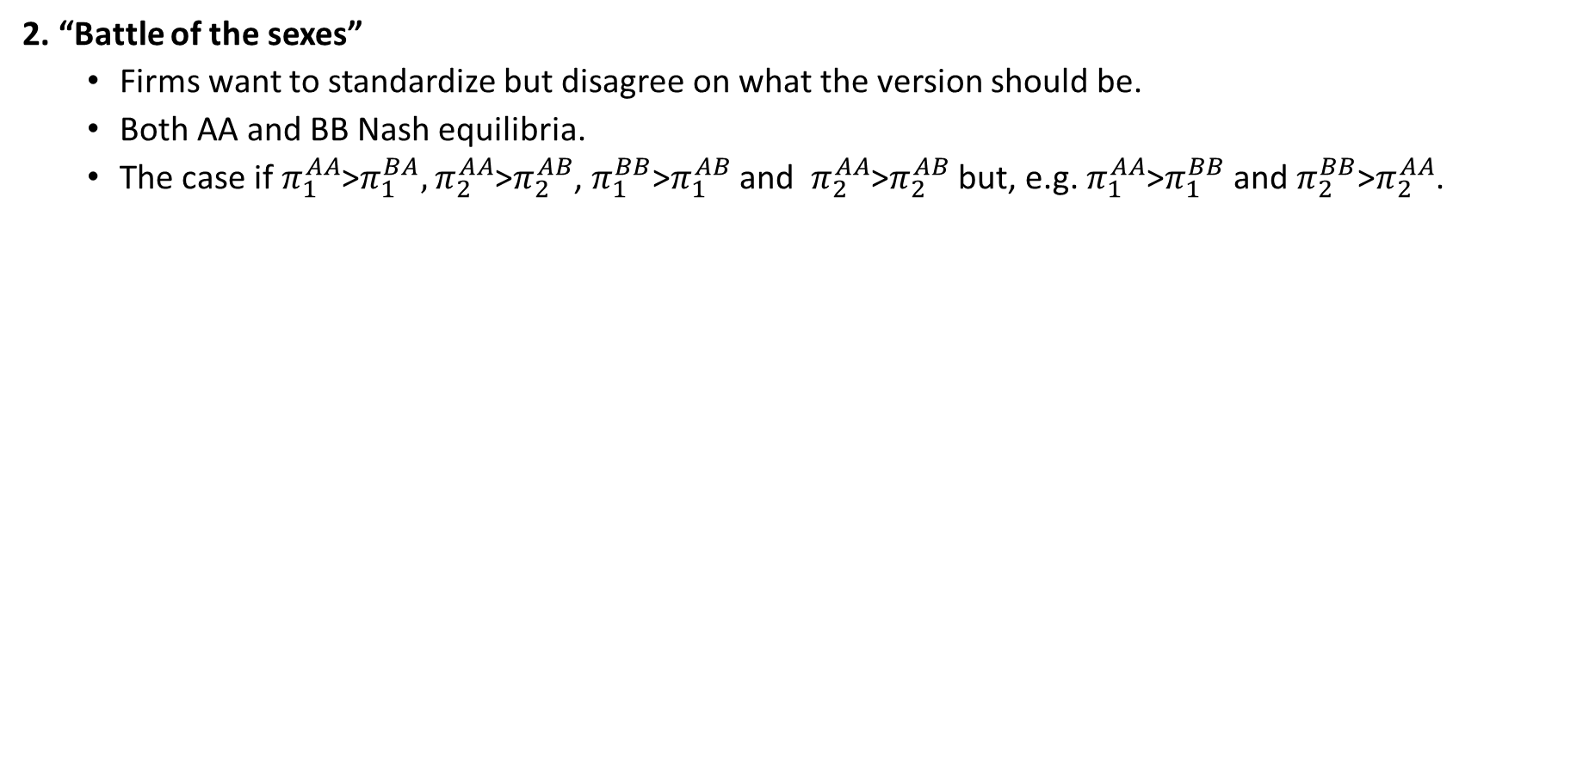
Standardisation game: 4 options
2. “Battle of the sexes”
Firms want to standardize but disagree on what the version should be.
Both AA and BB Nash equilibria.
The case if $π_{1}^{AA}$>$π_{1}^{BA},$ $π_{2}^{AA}$>$π_{2}^{AB}$, $π_{1}^{BB}$>$π_{1}^{AB}$ and $π_{2}^{AA}$>$π_{2}^{AB}$ but, e.g. $π_{1}^{AA}$>$π_{1}^{BB}$ and $π_{2}^{BB}$>$π_{2}^{AA}$.

Slide 54
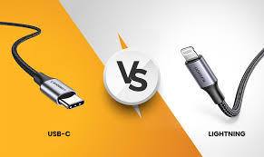
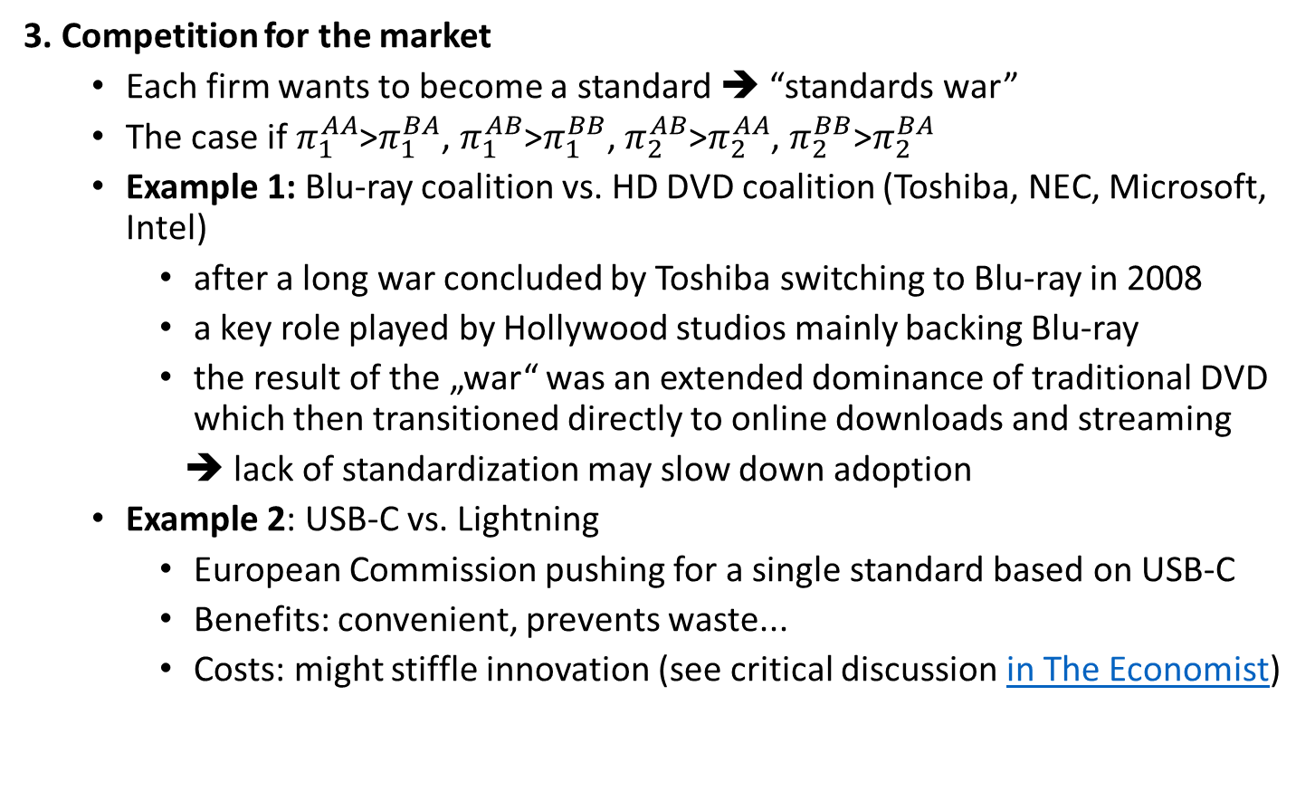
Standardisation game: 4 options
3. Competition for the market
Each firm wants to become a standard ➔ “standards war”
The case if $π_{1}^{AA}$>$π_{1}^{BA}$, $π_{1}^{AB}$>$π_{1}^{BB}$, $π_{2}^{AB}$>$π_{2}^{AA}$, $π_{2}^{BB}$>$π_{2}^{BA}$
Example 1: Blu-ray coalition vs. HD DVD coalition (Toshiba, NEC, Microsoft, Intel)
after a long war concluded by Toshiba switching to Blu-ray in 2008
a key role played by Hollywood studios mainly backing Blu-ray
the result of the „war“ was an extended dominance of traditional DVD which then transitioned directly to online downloads and streaming
➔ lack of standardization may slow down adoption
Example 2: USB-C vs. Lightning
European Commission pushing for a single standard based on USB-C
Benefits: convenient, prevents waste...
Costs: might stiffle innovation (see critical discussion in The Economist)

Slide 55


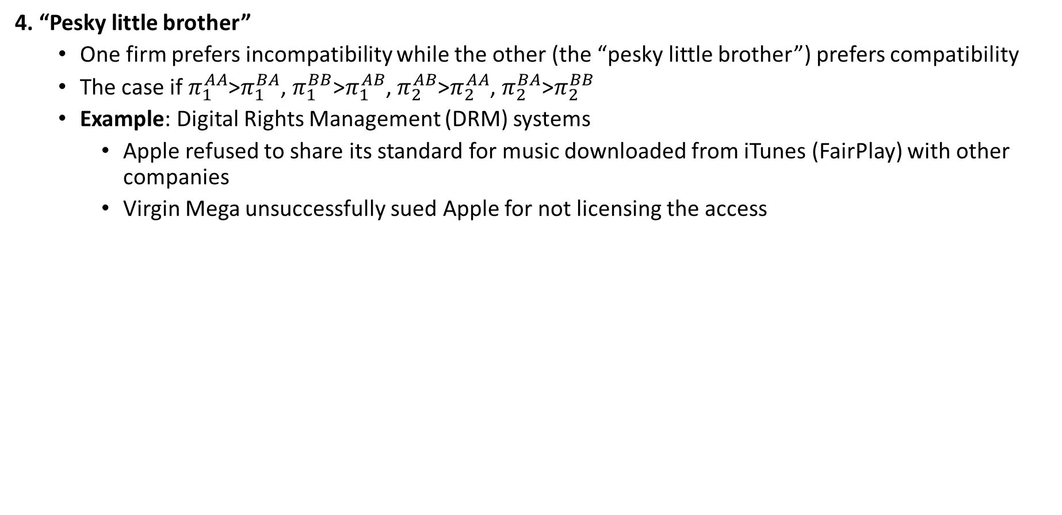
Standardisation game: 4 options
4. “Pesky little brother”
One firm prefers incompatibility while the other (the “pesky little brother”) prefers compatibility
The case if $π_{1}^{AA}$>$π_{1}^{BA}$, $π_{1}^{BB}$>$π_{1}^{AB}$, $π_{2}^{AB}$>$π_{2}^{AA}$, $π_{2}^{BA}$>$π_{2}^{BB}$
Example: Digital Rights Management (DRM) systems
Apple refused to share its standard for music downloaded from iTunes (FairPlay) with other companies
Virgin Mega unsuccessfully sued Apple for not licensing the access

Slide 56
Standardisation game: some results
Early standardization more likely if firms
More symmetric
Do not have strong preferences for particular goods
Consumer and producer interests differ because
Consumers don’t feel full costs of standardization
Producers don’t fully appropriate the benefits of standardization
Incompatibility can be used to deter entry if
Sufficiently strong network effects
AND Sufficiently poor compatibility
AND Sufficiently large installed base by the incumbent
A new superior product will want to be
Compatible if the improvement rather incremental (to steal a lot of customers)
Incompatible if the improvement very large (to lock-in their customers)

Slide 57
Network effects and public policy
Lack of standardization bad for consumers and may even slow down technology adoption.
Could public policy help?
Ex-ante interventions
Enters the competition process among network goods
Faces substantial challenges
Imposing chosen standard is low-cost and efficient only for a short initial period
But during this initial period, it is very hard to know which standard is better
Example: European Commission pushing for USB-C
Ex-post interventions
Intervene ex-post through anti-trust policy etc.
Competitive benchmark not relevant in the presence of network effects
But there can be useful limits on exclusive dealing, tying...
Example: Allow access: proposal to allow Facebook users to take their social graph to a different platform

Slide 58
Network effects and public policy
Should cooperation on standards setting be allowed?
A key trade-off: competition for the market vs. competition in the market
Cooperation not allowed ➔ competition for the market
Intense competition and innovation in near term
Monopoly in the future
Cooperation allowed ➔ Competition in the market
Competition in the future
But competition and innovation reduced in near term

Slide 59

Give 3 examples of direct network effects
Give 3 examples of indirect network effects
Give an example of negative network effects
Why is „critical mass“ a key feature of many markets with network effects?
What are the arguments pro and against standards mandated by the government?
What questions do you have?

